Slide 1


Annamacharya Institute of Technology and Sciences, AUTONOMOUS :: Rajampet
Project Review
A Presentation
On
“ Design and development of automated writing machine”
Group by :-
K. Chandrakala
N. Keerthi
V. Ayyappa Reddy
V.L. Bhanu Prakash Reddy
GUIDED BY :-
Mr.N. SREERAMULA REDDY
ASSISTANT PROFESOR
Electrical and Electronics Engineering
DEPARTMENT OF ELECTRICAL AND ELECTRONICS ENGINEERING

Slide 2
Contents:-
Introduction
Objective
Existing System
Proposed method
Tools Required
Working
Software Working
Future Plan

Slide 3
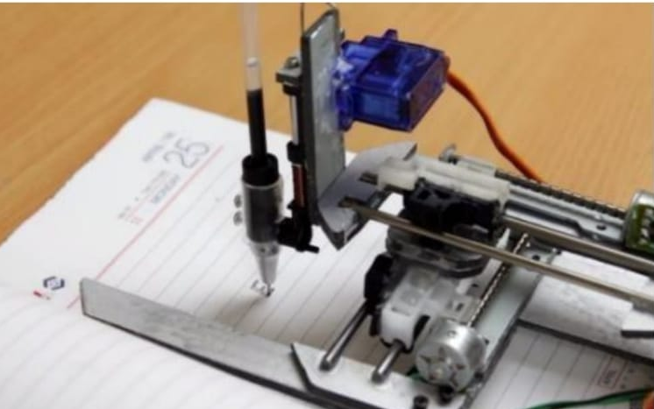
INTRODUCTION
We have the technologies like printers, scanners, etc. But the basic problem is it only
writes only those fonts which the computer already has. That is Roman, Calibri, Arial,
Impact, Georgia, etc. We want a machine which can write the full matter on a page by
the ink of pen in our own personal hand writing. By using the concepts like CNC
machines which make easy to scan the text. Similarly, we can use this technology
to make a machine for Writing purpose, but also used for Drawing purpose.

Slide 4
Objectives
The machine can be used for writing by giving the input to the machine.
This machine can able to write the text and drawing the diagrams, just like hand written notes and drawings.
The automated writing machine is used to save our time.

Slide 5
Existing System
The already existing technologies like printers, scanners is that they only write in predefined fonts present in the computer.
The proposed system works as an automated writing machine that is capable of Writing in any predefined font or in the user's hand writing style.

Slide 6
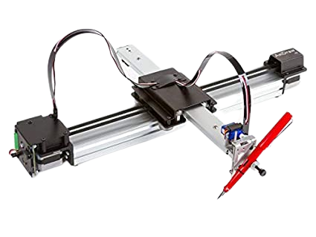
Proposed Method :-
INPUT
Text
Text Identification
Font converter
OUTPUT
WRITE – UP COPY
Block Diagram

Slide 7
Tools Required
Hard ware :-
Stepper Motor
Servo Motor
Rods

Slide 8
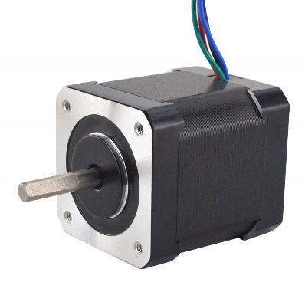
Stepper Motor:
These are electromagnetic devices that convert digital pulses into mechanical shaft rotation in discrete steps. These motors provide high accuracy, low cost, high torque, high reliability, and simplicity to the system. In the proposed system stepper motors like Nema 17 are used to achieve motion in the x and y-axis.
Specifications:
Step angle | 1.8 degrees
Current | 1.2 A/Phase
Holding Torque | 4.2 Kg-Cm
Detent Torque | 2.2N.Cm
Lead Wire | 4
Shaft Diameter | 5mm

Slide 9
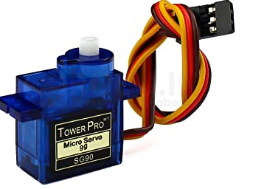
Servo Motor:
Servo motors are special electromagnetic devices that produce precise degrees of rotation. Servo motors work on the principle of pulse width modulation, where the applied pulse duration given to the control pin controls the motor’s rotation angle.
Specifications:
Weight | 55gm
Dimensions | 39.5mm*20.5mm*40.7mm
Operating Voltage | 4.8 ~ 6.6 V
Gear type | Metal Gear
Temperature range | 0- 55 Deg
Servo wire length | 30 Cms
Speed | 3000 – 5000 rpm
Operating Speed | 0.20 sec / 60 Degrees (4.8 V)

Slide 10
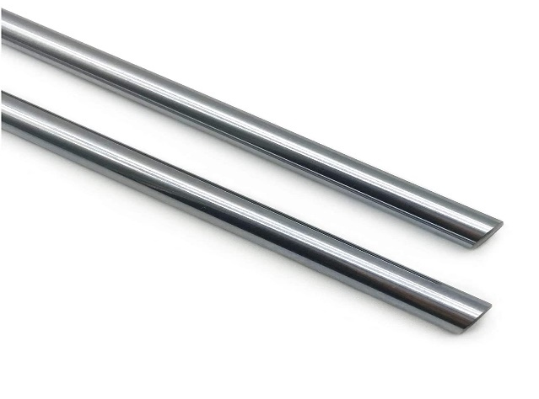
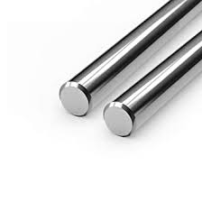
Linear Rods:
Long, thin, straight metal bars known as linear rods are frequently utilized in a variety of applications that call for load-bearing or structural support.
1. Robotics: Precision linear motion in the X, Y, and Z axes is provided by linear rods in robotics applications.
2. Manufacturing: In order to support numerous components, including convey or systems, assembly lines, and machining equipment, linear rods are employed in manufacturing processes.
Specifications: Linear Rod - 450mm
Diameter | 12mm
Length | 450mm
Tolerance | -0.005mm to -0.03mm
Linear Rod - 350mm
Specifications:
Diameter | 8mm
Length | 350mm
Tolerance | -0.005mm to -0.03mm

Slide 11
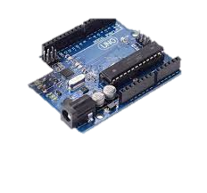
Software
Arduino:- Arduino is an open-source electronics platform based on easy-to-use hardware and software. Arduino boards can read inputs – light on the sensor, and turn it into an output – activating a motor, turning on an LED, publishing something online.

Slide 12
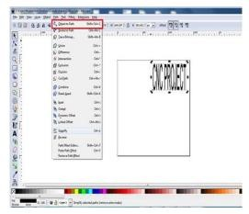
Inkscape 0.9.2
To create the plotted figure or text, use Inkscape. With this software, a G-code file of a chosen image or piece of text is made for this project. X, Y, and Z coordinates are part of the widely used numerical control programming language known as G-code..

Slide 13
G – CODER: -
"G" is presenting this. G-codes are pre-defining functions linked to Machine Axis Movement. It is a two-digit number, such as G00, G81, or G90. It is possible to place multiple G addresses in a single block. As long as these Functions do not conflict with one another. G02 and G03, which are located together in a single block, are not permitted. The path that must be taken to create a whole design is specified by the g function. positioning with
ExG00- positioning.
G01- Linear interpolation
G02- Clockwise Circular Interpolation
G03- Counter clockwise Circular Interpolation G04- Dwell

Slide 14
WORKING
Install the inkscape, UGS, 4XIDraw Tool software in system.
The programming code will be uploaded in the Arduino uno board once the devices is fixed.
The sensors used recognize the user input and fetch user input with stored document and return results and start writing on paper.

Slide 15

Software Working
Step 1: Install Inkscape software 0.9.2

Slide 16

Step 2: Open the Inkscape application

Slide 17

Step 3: After that we can take text option and text

Slide 18
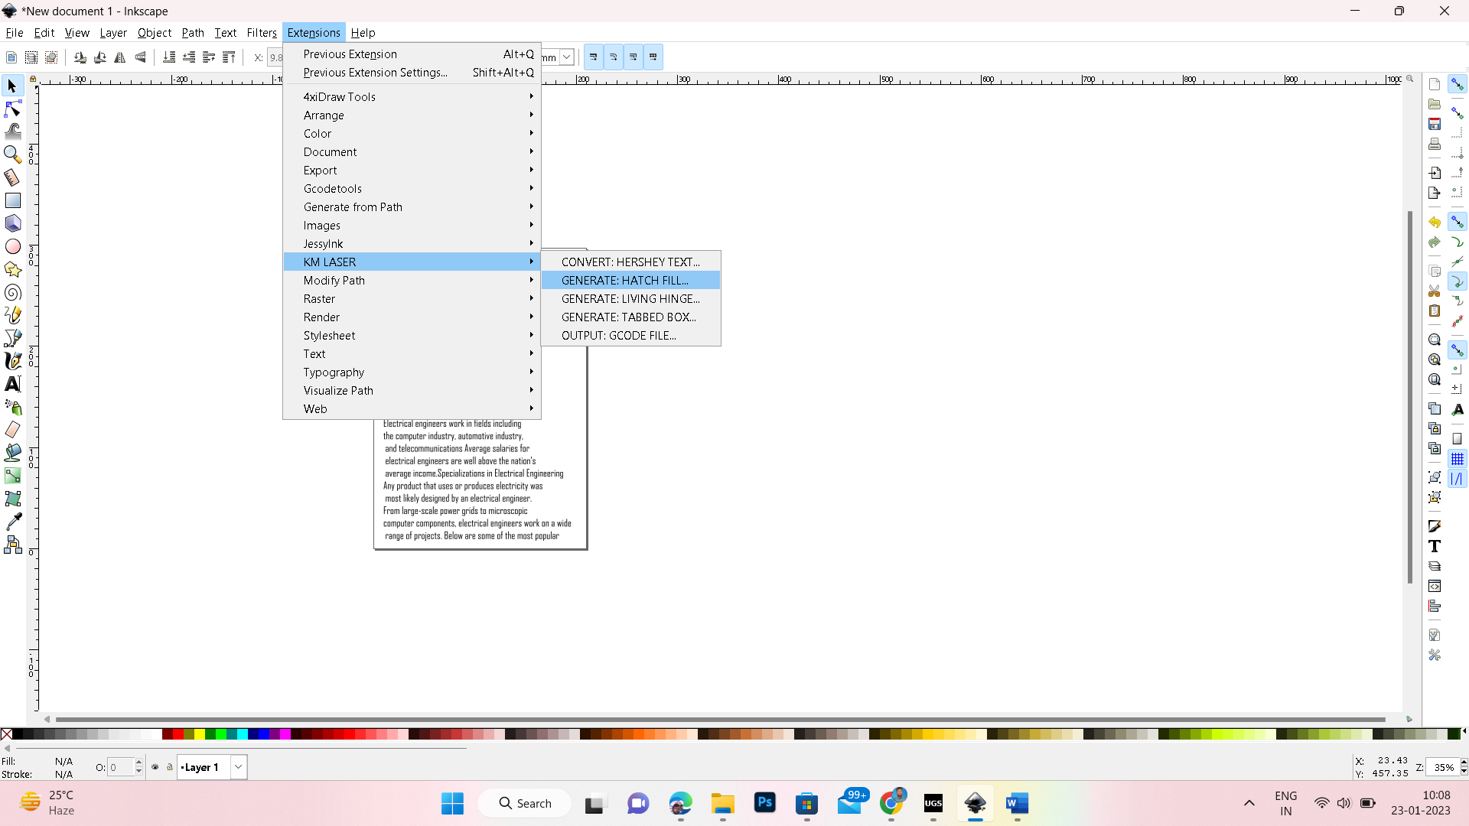
Step 4: We will go to the extension file and we can select “KM laser” in that file.in
KM laser we can select “convert Hershey text” (for converting text into different fonts)

Slide 19
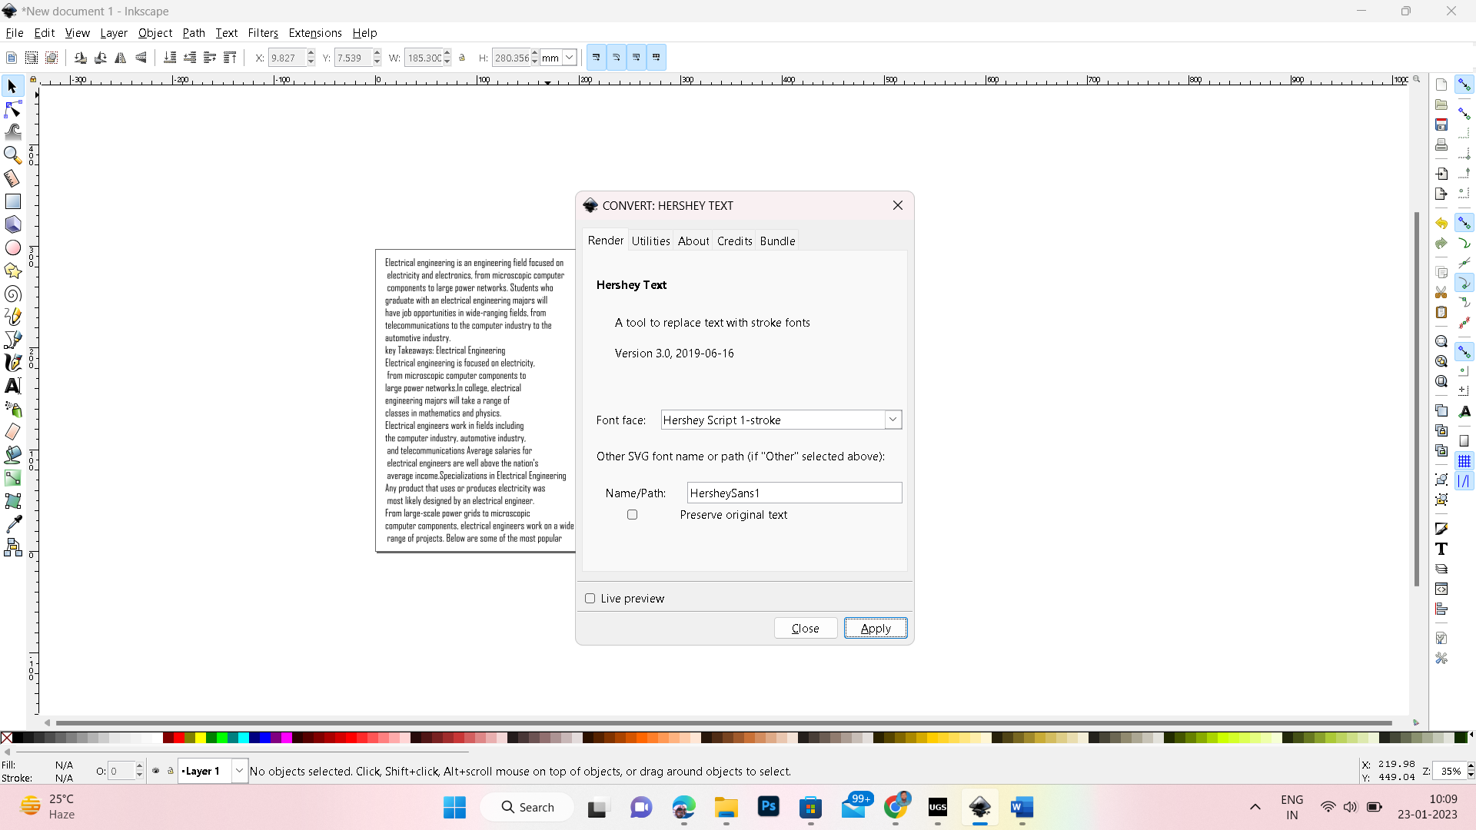

Slide 20

Step 5: After that font has been applied then it is converted in a selected font.

Slide 21
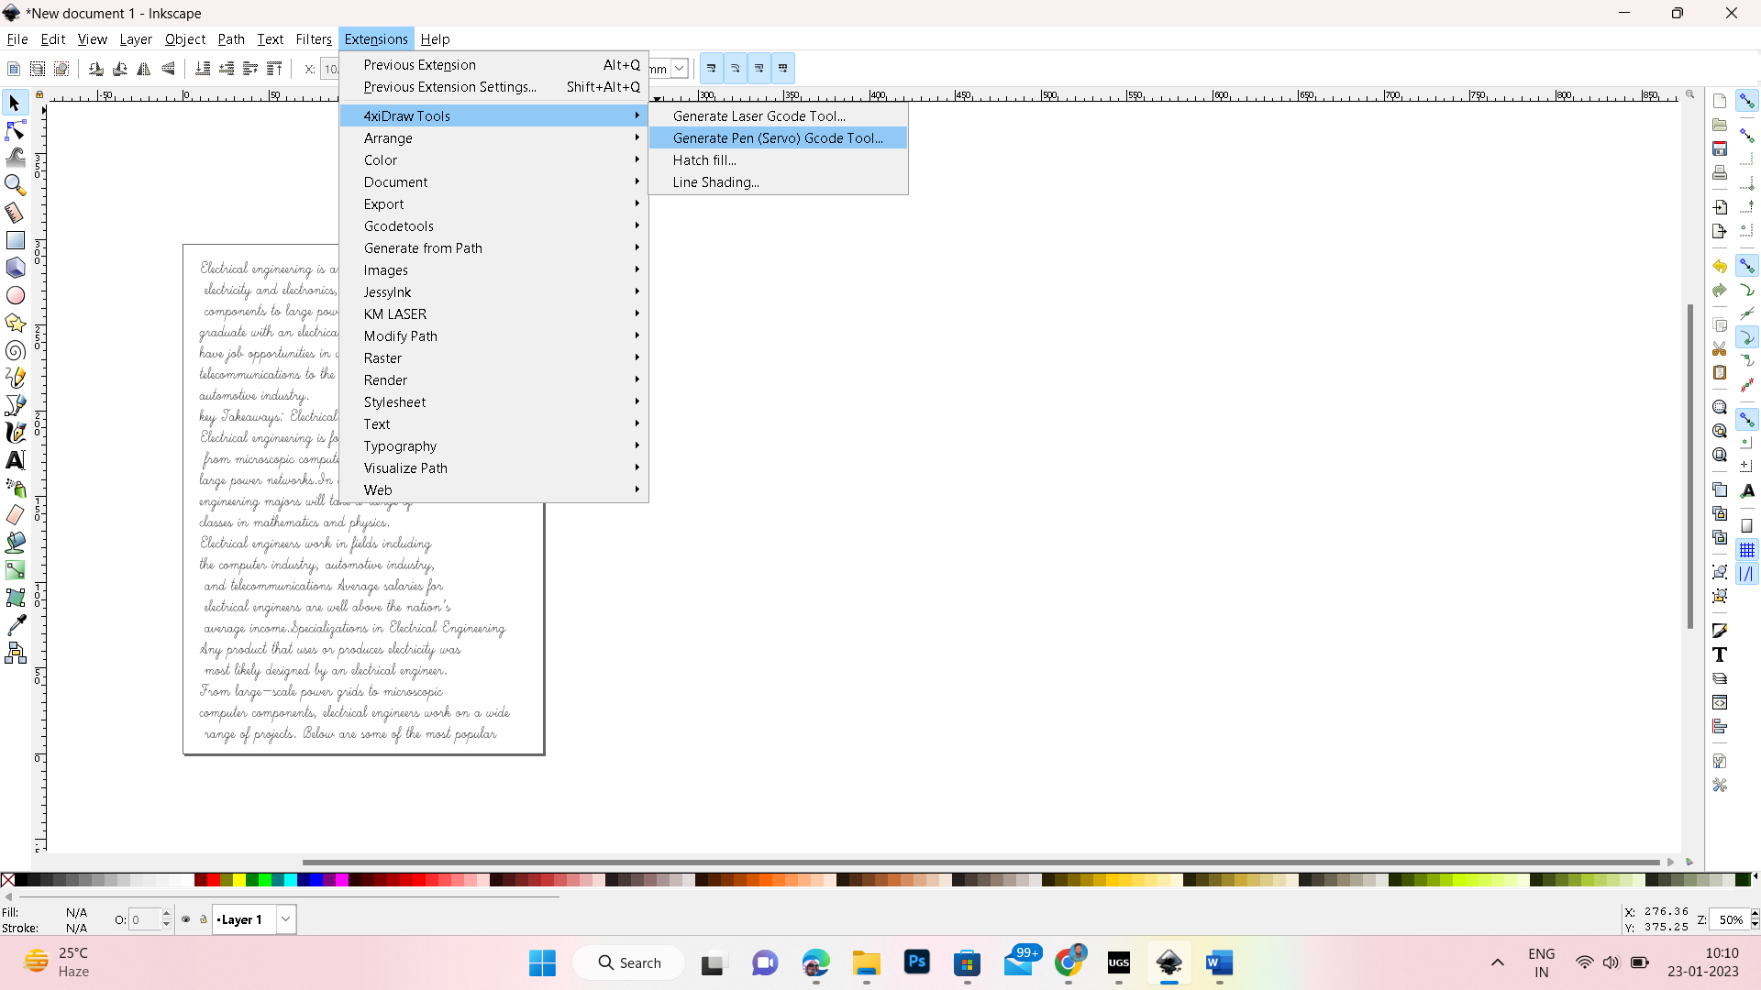
Step 6: We will go to the extension file to select “4xdraw tools” again and select “generate pen GCODE tool”.

Slide 22
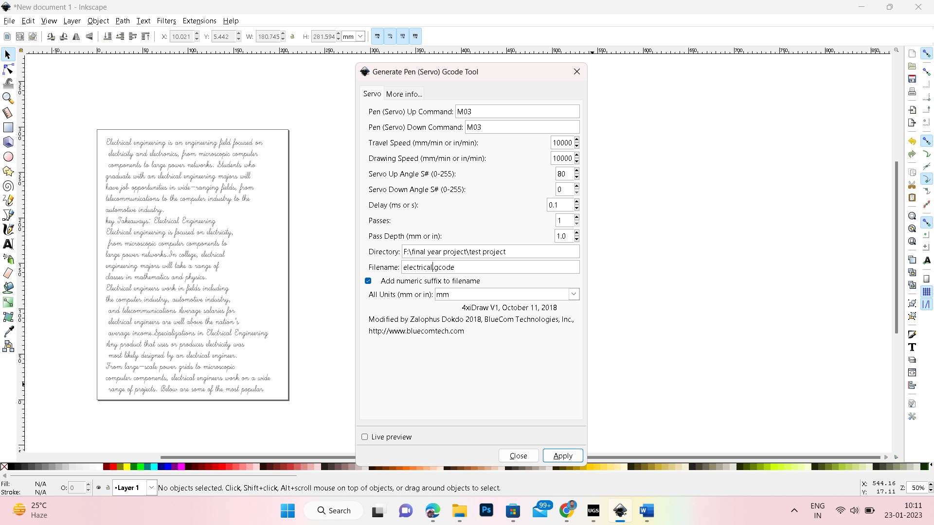
Step 7: We can select pen movement (up and down) travelling speed, servo angles and delay time.In dictionary we can select file location after we can give file name and click on the “apply” option

Slide 23
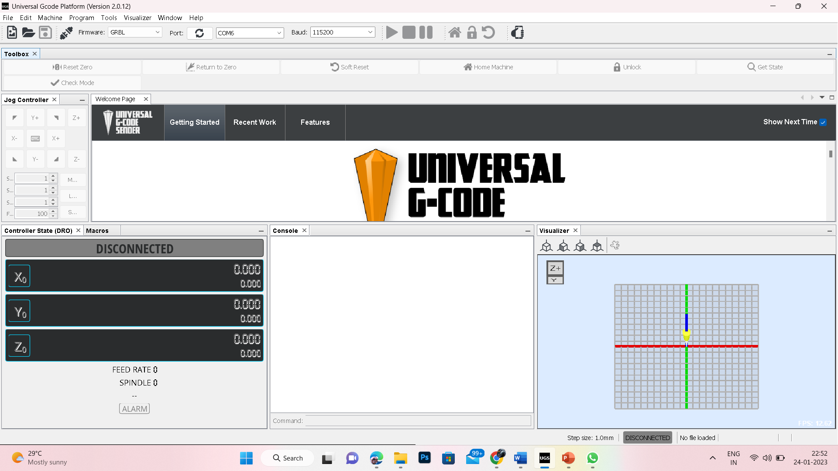
Step 8: Next open UGP (universal Gcode platform) version 2.0.12. we can connect Arduino connection whether it is Connect or not.

Slide 24
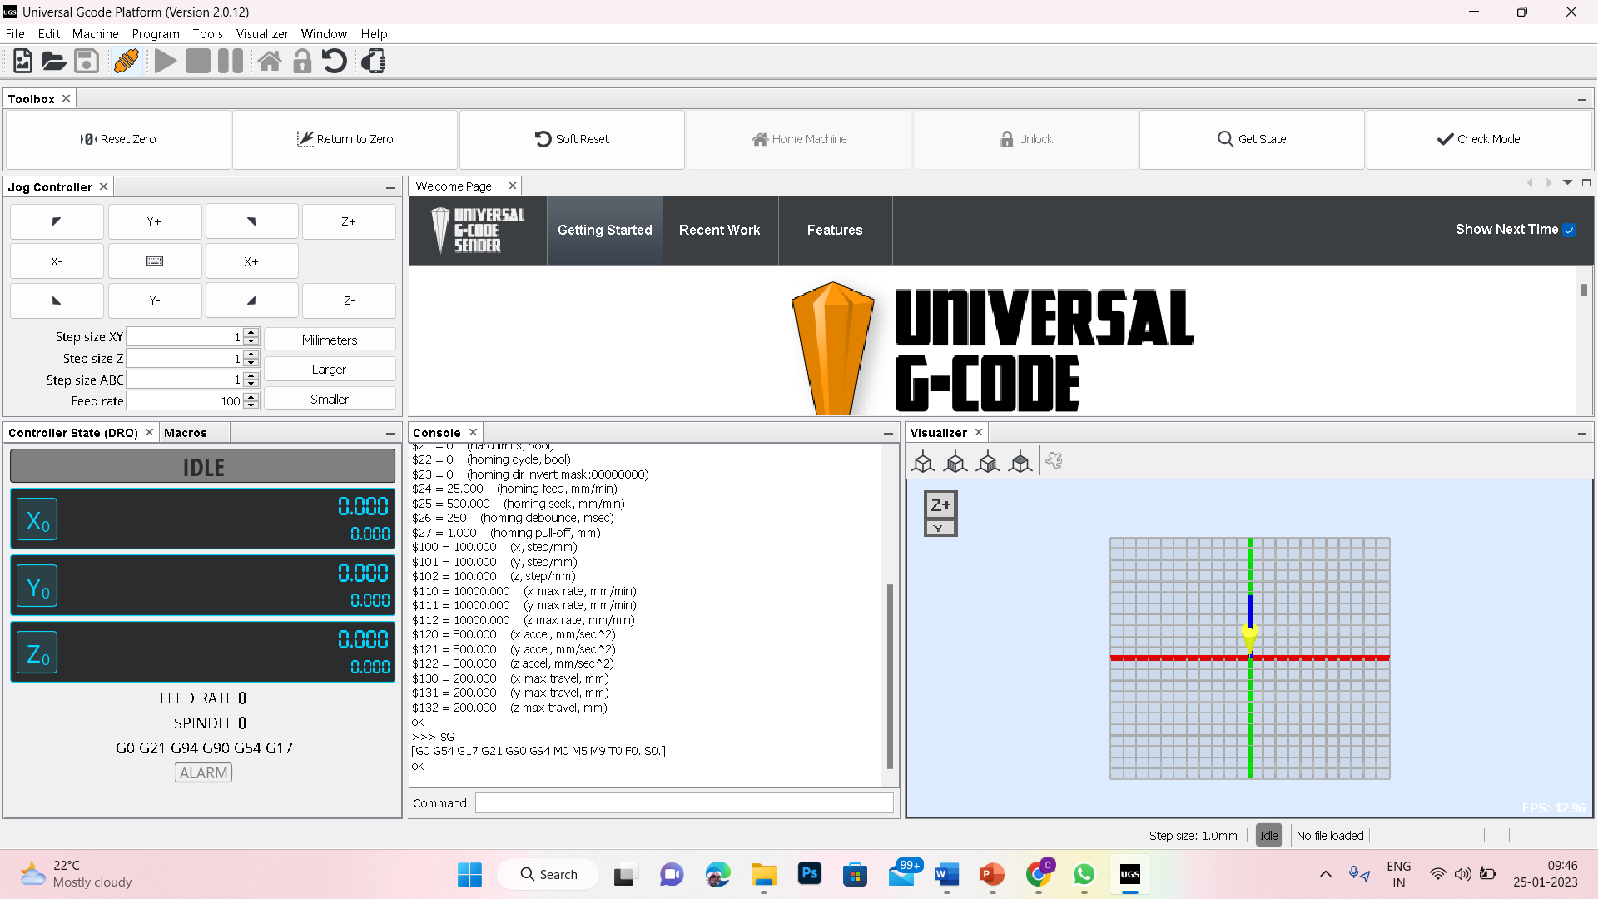
Step 9: Click on the connect or disconnect option. It is connected open file we can select file already which is saved in the inkscape.

Slide 25
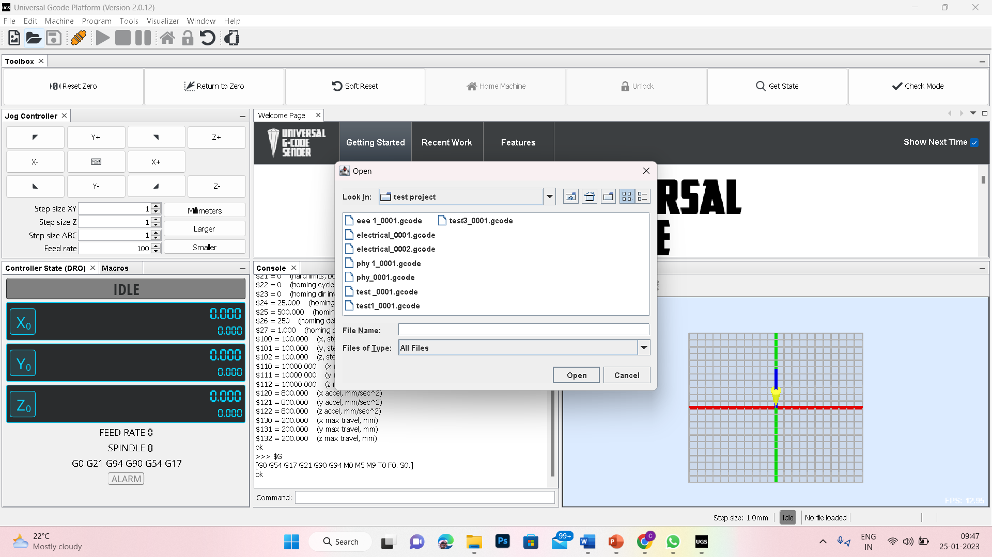
Step10: After that we can select the file and open it. The automatically the source will display

Slide 26
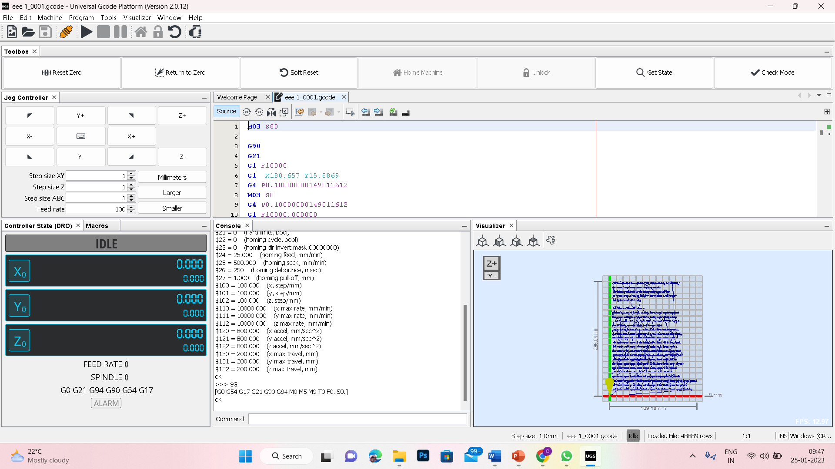
Step 11: In control state (DRO). We can set x-axis, y-axis and z-axis are zero. after we can run it.Before starting the pen movement in console we have to give
commands for pen up and down.
Pen up=M03 S80
Pen down=M05 S10

Slide 27
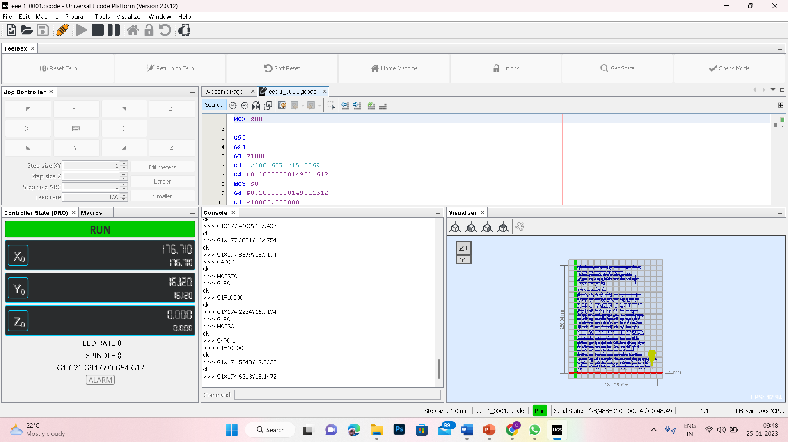
Step 12: After that it shows the pen movement how much speed it goes on x, y, and z-axis.

Slide 28
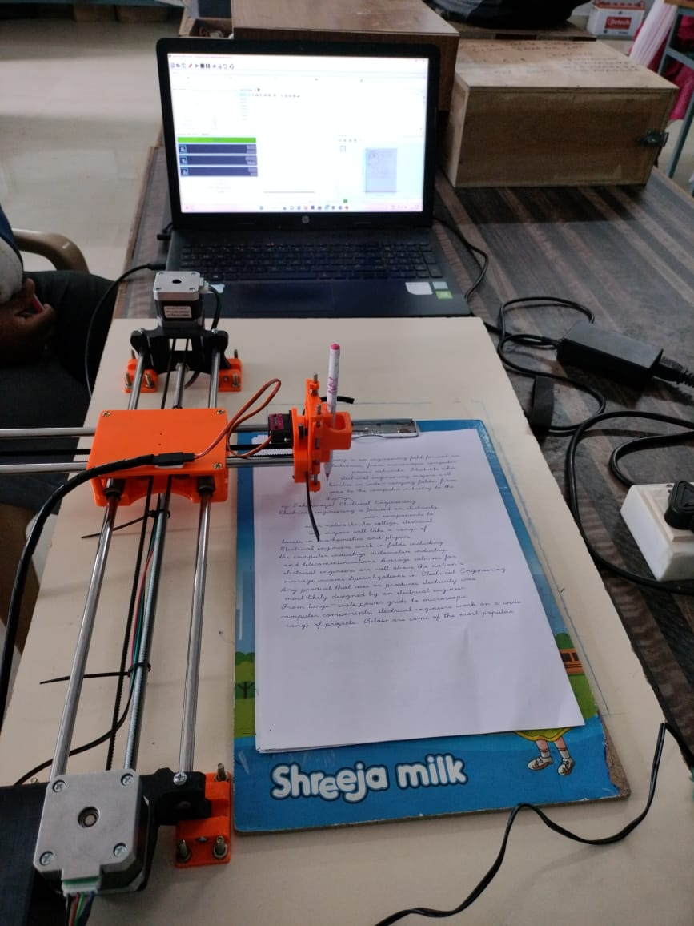

Slide 29
WORKING MECHANISM
Software
GCode
Input document / text writing
Text Text Font Detection Extraction Conversion
Image Generated
User Interface Terminal Software
Hardware
Power supply
Ardunio Board
Stepper Motor
Gantry setup
Servo motor
Pen movement

Slide 30

Results
Amazon, the multinational e-commerce grant, has done the impassible and reached a staggering 18 Trillion dillars market cap in the past few years, and is expected to reach over 18 Trillion in revenues by the year 2025.
INPUT
OUTPUT

Slide 31


Input image
Output image

Slide 32
FUTURE PLAN
The proposed system can be used as a baseline setup for many future modifications
Increase the speed of writing compared to the speed achieved currently.
Inclusion of voice-to-text modules in the already proposed system, which will be beneficial for differently abled people.
The system can be extended to read doctor’s prescriptions which in turn can be converted to the user’s language using a language translation model.

Slide 33
THANK YOU…

